Slide 1
Consumer Flow - Genesis

Slide 2
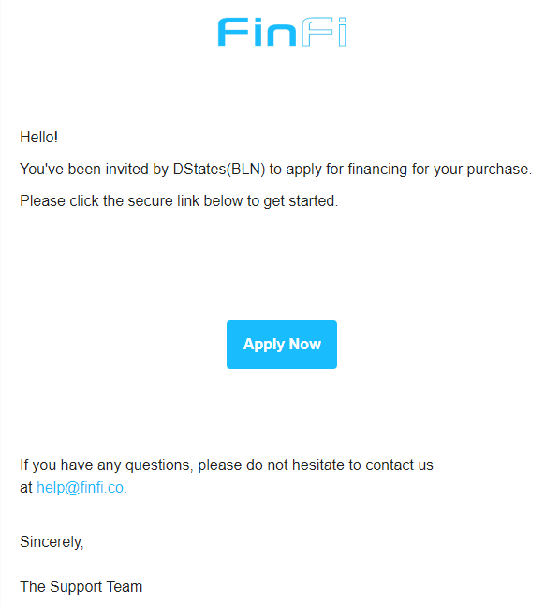
Customer receives an email from help@finfi.com
Consumer clicks on “Apply Now”

Slide 3
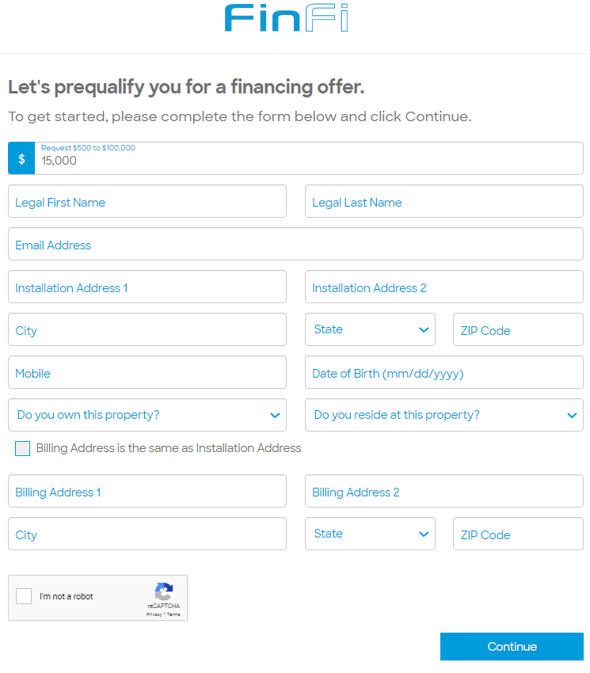
Billing Information
All fields are to be filled:
Requested loan amount (this can be edited at this time)
Legal First Name
Legal Last Name
Email Address
Installation Address
Date of Birth
Do you own this property? (Yes/No)
Do you reside at this property? (Yes/No)
Billing Address
Information provided should match the customer. A mismatch can trigger a fraud alert and may delay funding or cause the application to pend.

Slide 4
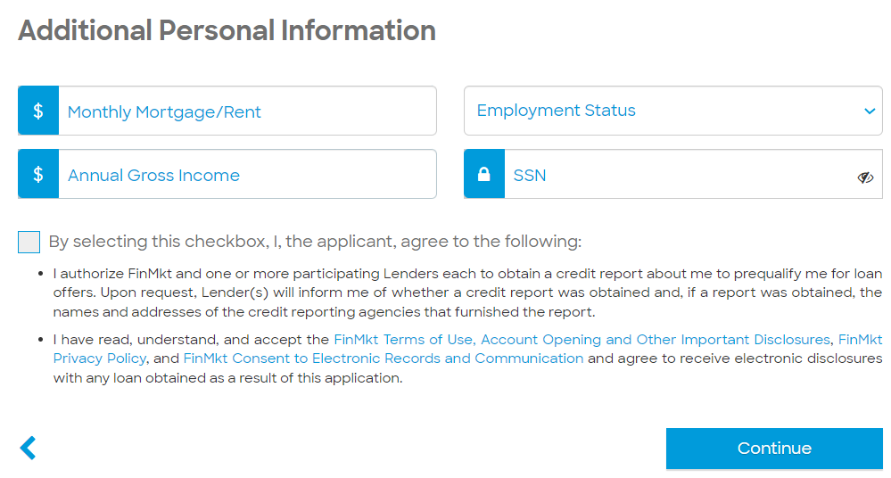
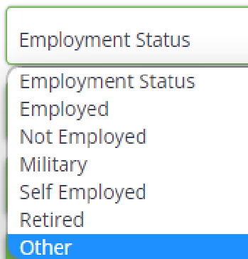
Additional Personal Information
Required Personal Information:
Monthly Mortgage/Rent – The Amount consumer commits as EMIs on monthly basis.
Employment Status - Choose one of the employment options listed.
Social Security Number
Annual Gross Income – Total Amount that a consumer earns in a year

Slide 5
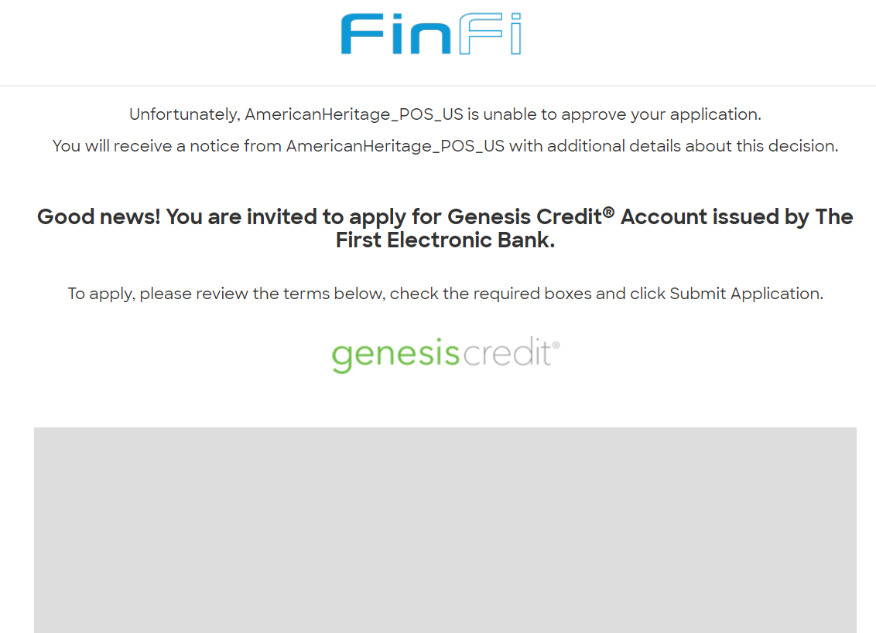
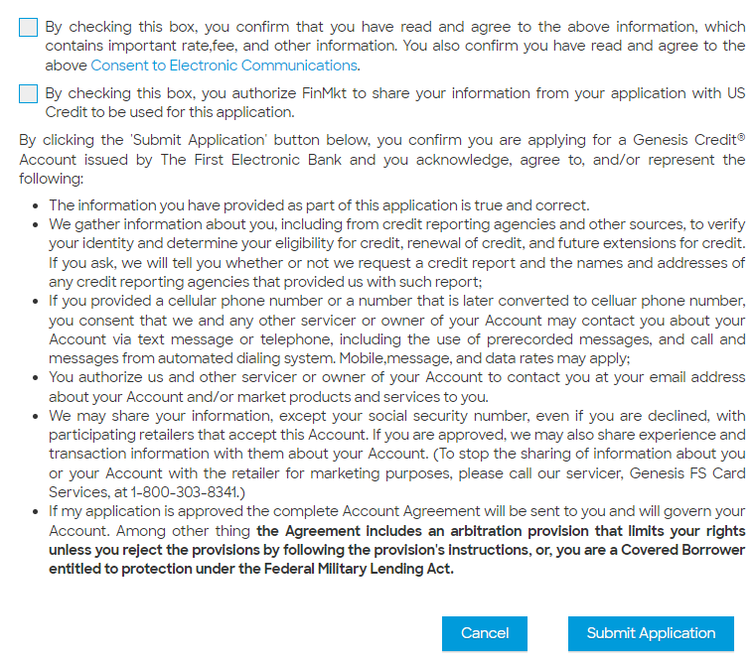
Lender Disclosure

Slide 6
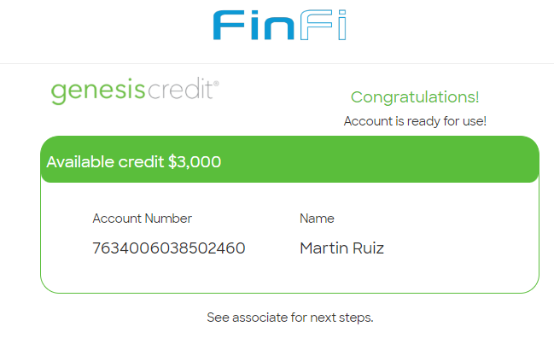
All Set!
Genesis does both Soft pull and Hard pull at the same time and provide approval for the amount.
This amount may vary from what actually had been requested.

Slide 7
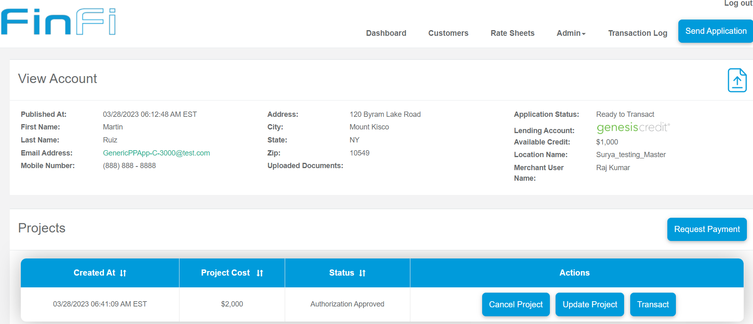
Authorization Approved
After the amount gets authorized, merchant needs to ‘Add Project’.
That will send an SMS to the consumer. Consumer approves the amount.
After consumer approves, merchant will see the “Request Payment” option.
Merchant can ‘Update the Project’ and ‘Cancel the Project’.

Slide 8
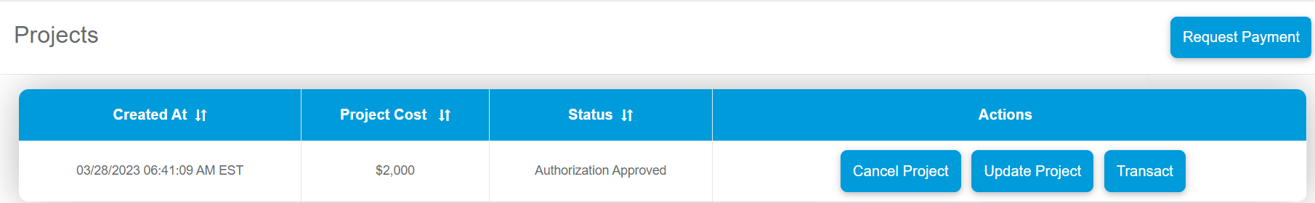
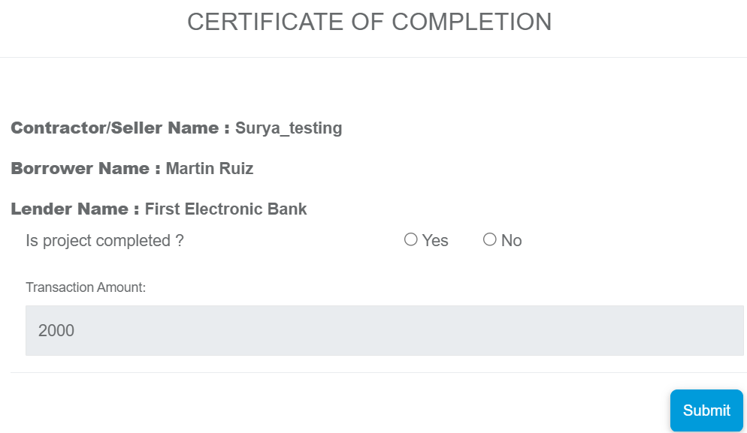
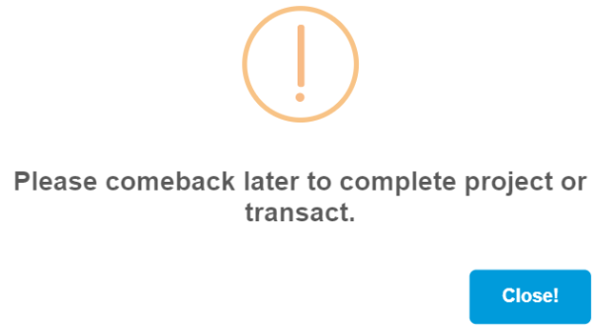
Request Payment
Merchant clicks on “Request Payment”, a page pops up.
Merchant confirms if the project is complete or not.
If the answer is ‘No’ then there would be below pop up.

Slide 9
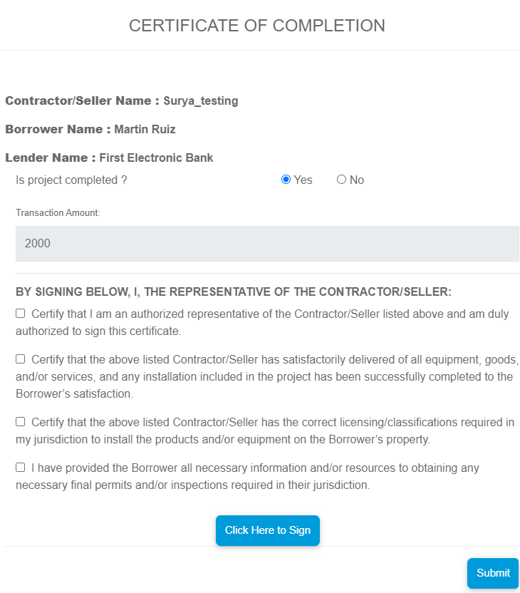
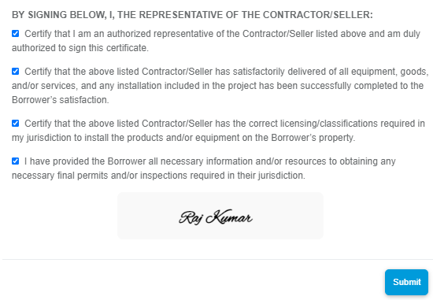
If the Project is completed
If the Project is completed, merchant selects ‘Yes’.
Then merchant selects the check points and e-sign by clicking ‘Click here to Sign’
Then ‘Submit’ it.

Slide 10
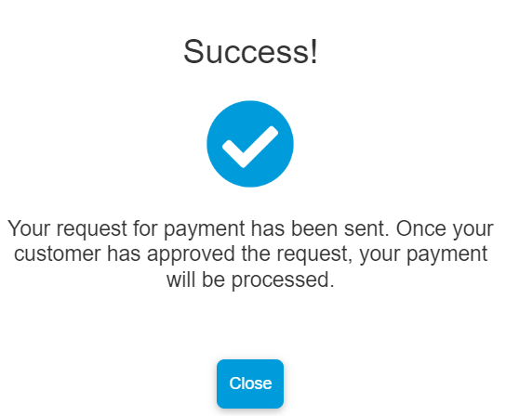
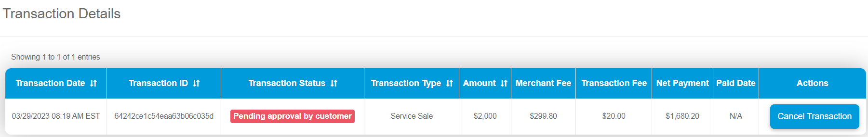
Request will go to the consumer for approval.
Consumer has to approve the ‘Requested Payment’. Merchant can see the Transaction Status as ‘Pending approval by customer’ in Merchant Portal.

Slide 11
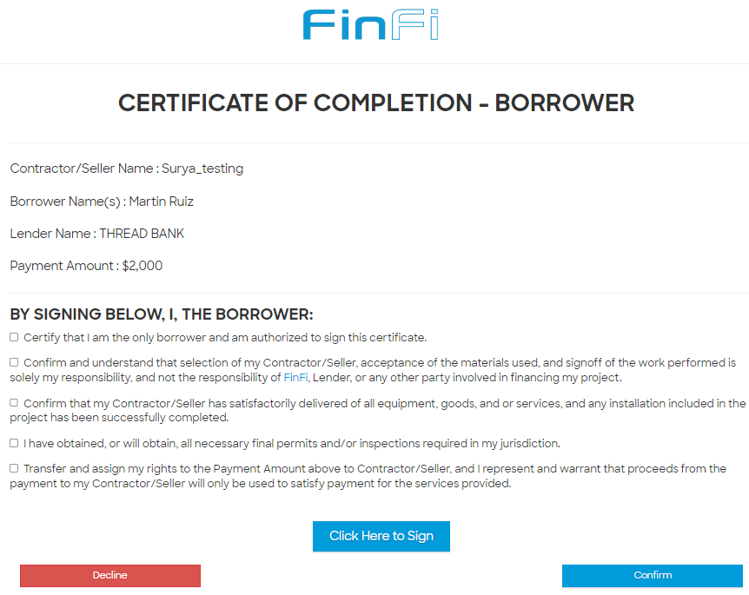
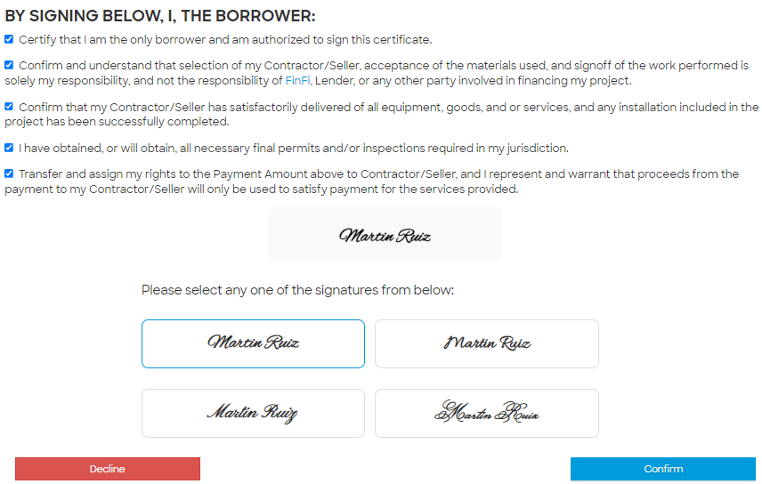
Consumer Approval for the payment
Consumer selects the checkboxes and signs on the ‘Certification of Completion’
Then clicks on ‘Confirm’

Slide 12
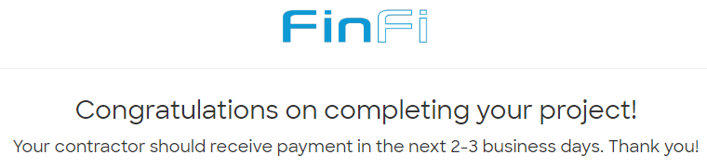
Congratulatory message- All Set for Merchant

Slide 13
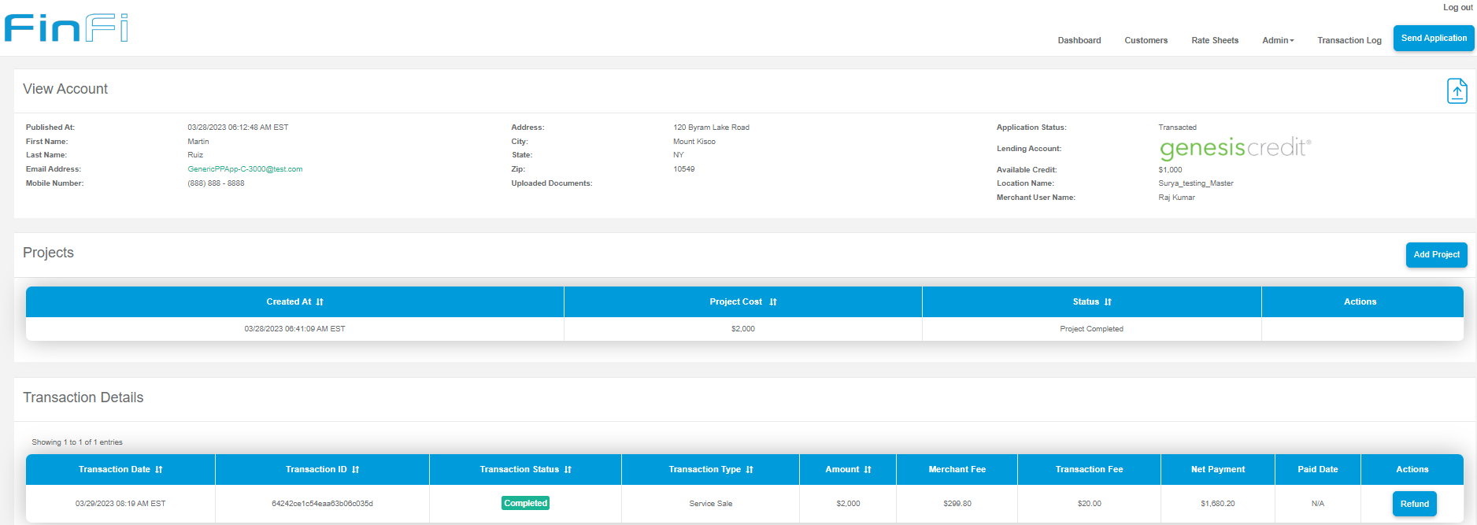
Transaction Complete

Slide 14
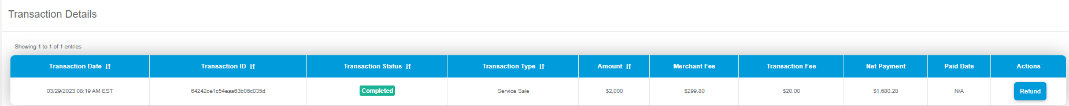
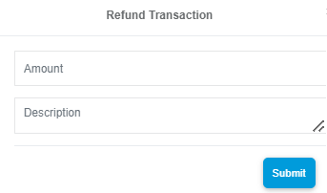
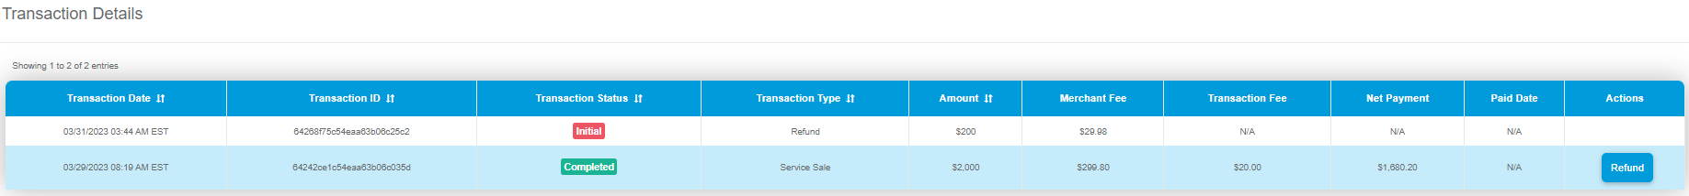
Refund Process
Merchant clicks on refund if he has some amount to refund, the above pop up appears and enters amount and describe the refund.
It gets initiated and goes for approval.

Slide 15
Thank you!

